Slide 1
Marketing from Any Seat in the Library
Chris Boivin
Peace Library System Symposium 2024
May 31, 2024

Slide 2
Library marketing can be hard
Little or no time/money
New/accidental marketers
Hard to get buy-in/expectations
Noise/confusion
Notes:
Book club for library marketers
People tell me the things that they most want to solve
These are the things that make marketing difficult

Slide 3
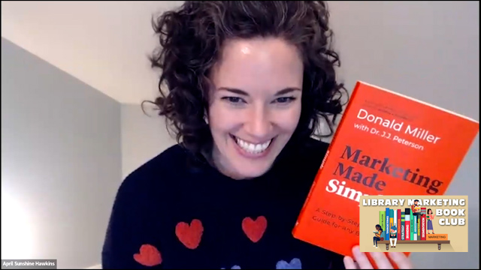
“Marketing should be easy and it should work.”
– Dr. J. J. Peterson and April Sunshine Hawkins
Marketing Made Simple podcast
Notes:
April and J.J. are the hosts of the podcast
Mantra – marketing should be easy and it should work

Slide 4
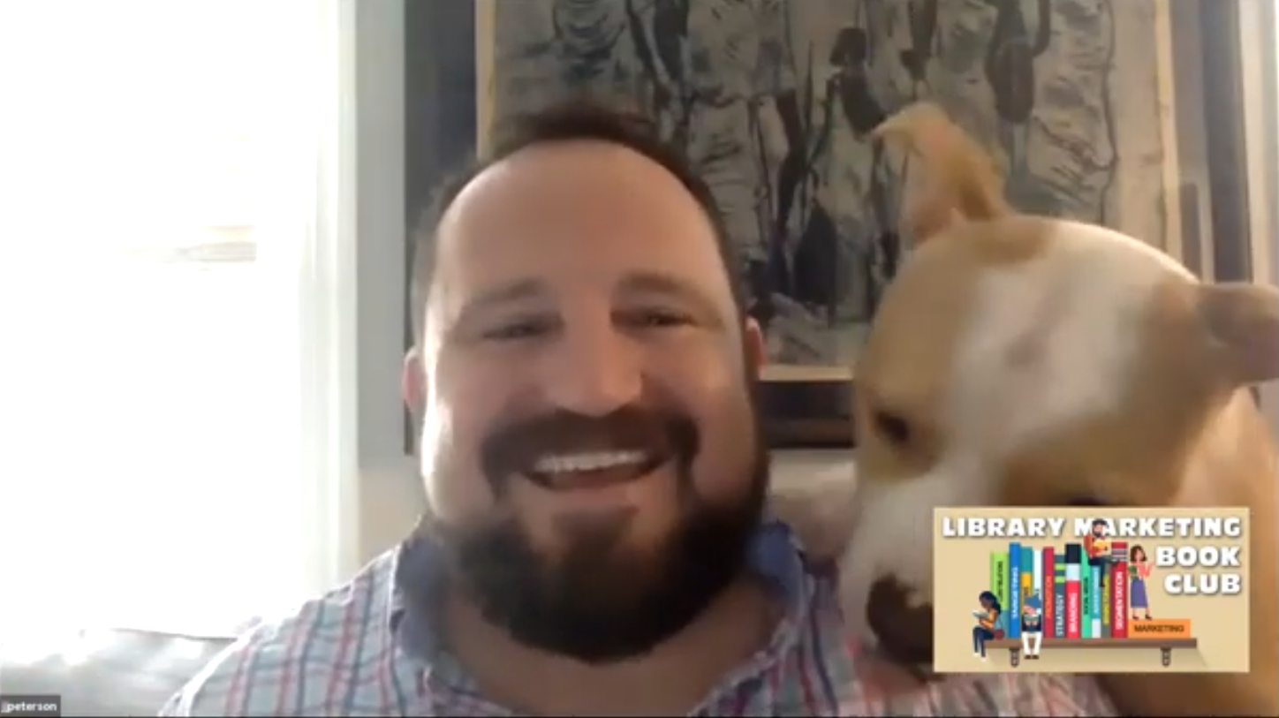
“Your customers are not curious about you; they are curious about how you can help them solve their problem.”
– Donald Miller and Dr. J. J. Peterson
Marketing Made Simple
Notes:
J.J. first guest first meeting
Co-writer of Marketing Made Simple book
Customers want to know how you can help them

Slide 5
Marketing should be easy
Character (hero)
Problem
Guide
Plan
Action
Avoid failure
Success
“Nearly every human being is looking for a guide (or guides) to help them win the day.”
— Donald Miller, Building a Story Brand

Slide 6
Marketing should be easy
People have problems
Show them you can be their guide
Sales funnel
“Your customers are not curious about you; they are curious about how you can help them solve their problem.”
— Donald Miller, Marketing Made Simple
Notes:
One-liner
Website
Lead-generating PDF
Email nurture campaign
Email sales campaign

Slide 7
Sales Funnel
One-liner
Website
Lead-generating PDF
Email nurture campaign
Email sales campaign
“Your customers are not curious about you; they are curious about how you can help them solve their problem.”
— Donald Miller, Marketing Made Simple

Slide 8
One-liner
One liner
Problem
“Most parents get stressed when they think about taking their child to the Dentist.”
“Your customers are not curious about you; they are curious about how you can help them solve their problem.”
— Donald Miller, Marketing Made Simple
Notes:
If a story doesn’t have a problem it never gets started

Slide 9
One-liner
One liner
Problem
“Most parents get stressed when they think about taking their child to the Dentist.”
Solution
“At Kid’s Teeth, our fun and welcoming office puts kids at ease.”
“Your customers are not curious about you; they are curious about how you can help them solve their problem.”
— Donald Miller, Marketing Made Simple
Notes:
If a story doesn’t have a problem it never gets started

Slide 10
One-liner
One liner
Problem
“Most parents get stressed when they think about taking their child to the Dentist.”
Solution
“At Kid’s Teeth, our fun and welcoming office puts kids at ease.”
Result
“So kids aren’t afraid and their parents actually enjoy their dentist visit.”
“Your customers are not curious about you; they are curious about how you can help them solve their problem.”
— Donald Miller, Marketing Made Simple
Notes:
If a story doesn’t have a problem it never gets started

Slide 11
You try
One liner
Problem
“Most parents get stressed when they think about taking their child to the Dentist.”
Solution
“At Kid’s Teeth, our fun and welcoming office puts kids at ease.”
Result
“So kids aren’t afraid and their parents actually enjoy their dentist visit.”
“Your customers are not curious about you; they are curious about how you can help them solve their problem.”
— Donald Miller, Marketing Made Simple
Notes:
If a story doesn’t have a problem it never gets started
This is the core of content marketing…

Slide 12
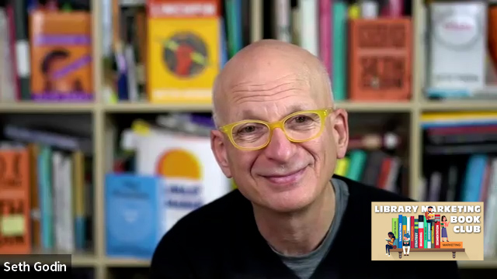
“Marketing is the generous act of helping others become who they seek to become. It involves creating honest stories—stories that resonate and spread.”
– Seth Godin
This is Marketing

Slide 13
Content Marketing
Not selfish
Not hype
Not pressure
“Marketing is the generous act of helping others become who they seek to become. It involves creating honest stories—stories that resonate and spread.”
– Seth Godin, This is Marketing

Slide 14
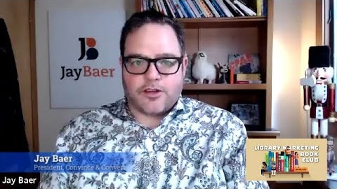
“What if instead of trying to be amazing you just focused on being useful? What if you decided to inform, rather than promote?”
– Jay Baer,
Youtility

Slide 15
Blogging and Web Content
Before: Journal that people subscribed to
Now: helpful, indexed information
Mugo website news
Other content: relevant and useful
“What if instead of trying to be amazing you just focused on being useful? What if you decided to inform, rather than promote?”
– Jay Baer,
Youtility
Notes:
Answer customer questions
Include keywords to attract people
Feature services you offer
Include book lists (if you can)
25,000 organic sessions/month

Slide 16
News on Mugo Site
Post as often as you can
Answer your patrons’ questions
Book Club in a Bag

Slide 17
Call to action
Use booklists
People won’t do anything if you don’t call them to action
“I didn’t know the library did that” isn’t a win without action.

Slide 18
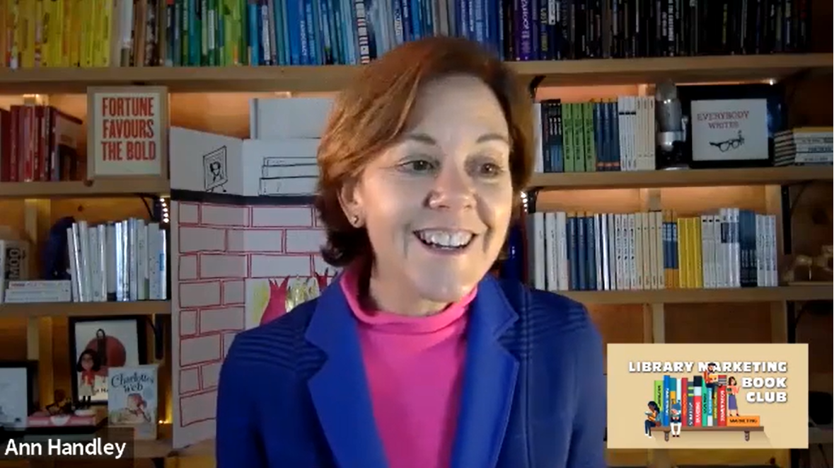
“If you’re not speaking to a specific audience, you’re speaking to no one.”
– Ann Handley, Everybody Writes

Slide 19
Email Marketing
Segmentation
Targeting
Customer is the hero
“If you’re not speaking to a specific audience, you’re speaking to no one.”
– Ann Handley, Everybody Writes

Slide 20
Building email lists
What are your patrons interested in?
Solve their problems

Slide 21
Building email lists
What are your patrons interested in?
Solve their problems

Slide 22
Building email lists
500 new subscribers/month
13,000 total subscribers in 4 years
Open rates 40-50%
Email-only promotion
Notes:
Avg 500 subscribers/month, 13,000 subscribers since 2020
Monthly emails, periodic emails
Rarely have to do much more promotion than email for these programs

Slide 24
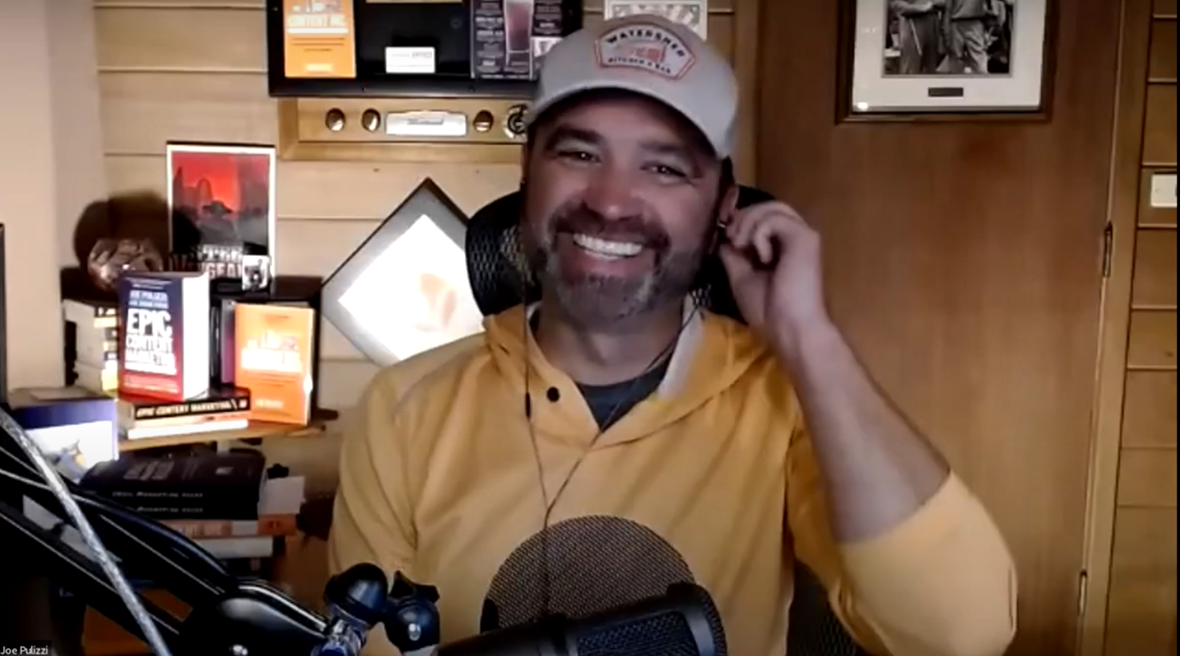
“Have you noticed how many fewer magazines and print newsletters you are getting in the mail these days?
– Joe Pulizzi,
Epic Content Marketing

Slide 25
Print Mail
Postcards
2- or 3-card series
Re-engagement and action
“Have you noticed how many fewer magazines and print newsletters you are getting in the mail these days?”
– Joe Pulizzi,
Epic Content Marketing

Slide 26
1,500 lower-income households
$4,500 ($1/piece x 3 cards)
70 users checked out equipment
More than 400 new cards
540 inactive users re-engaged

Slide 27
1,500 lower-income households
$4,500 ($1/piece x 3 cards)
70 users checked out equipment
More than 400 new cards
540 inactive users re-engaged

Slide 28
1,500 lower-income households
$4,500 ($1/piece x 3 cards)
70 users checked out equipment
More than 400 new cards
Almost 500 inactive users re-engaged

Slide 29
Plan
Call to action

Slide 30
Plan
Call to action

Slide 31
Plan
Call to action

Slide 32
Library marketing should be easy
Use your one-liner
Win on Google with news on your site
Build an email list (contact NoveList for setup help)
Consider print mail

Slide 33
Bonuses
Join the library marketing book club (it’s free!)
www.librarymarketingbookclub.org
Download the free Sales Funnel Plan
www.marketingmadesimple.com

Slide 34
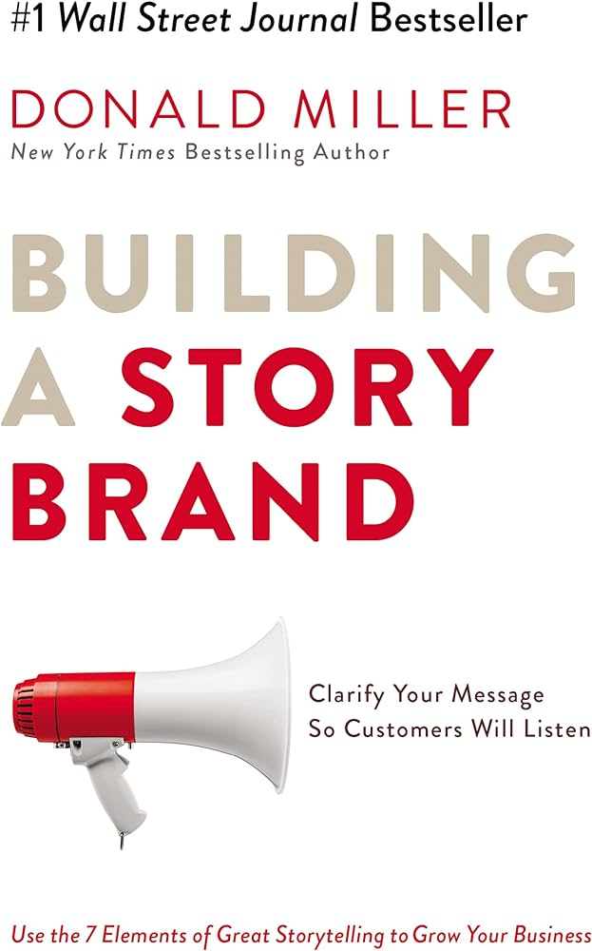
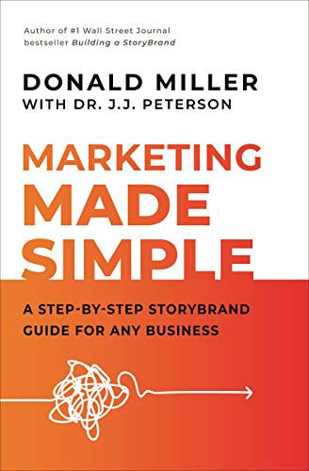
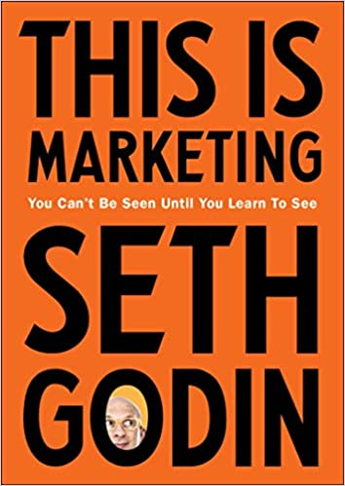
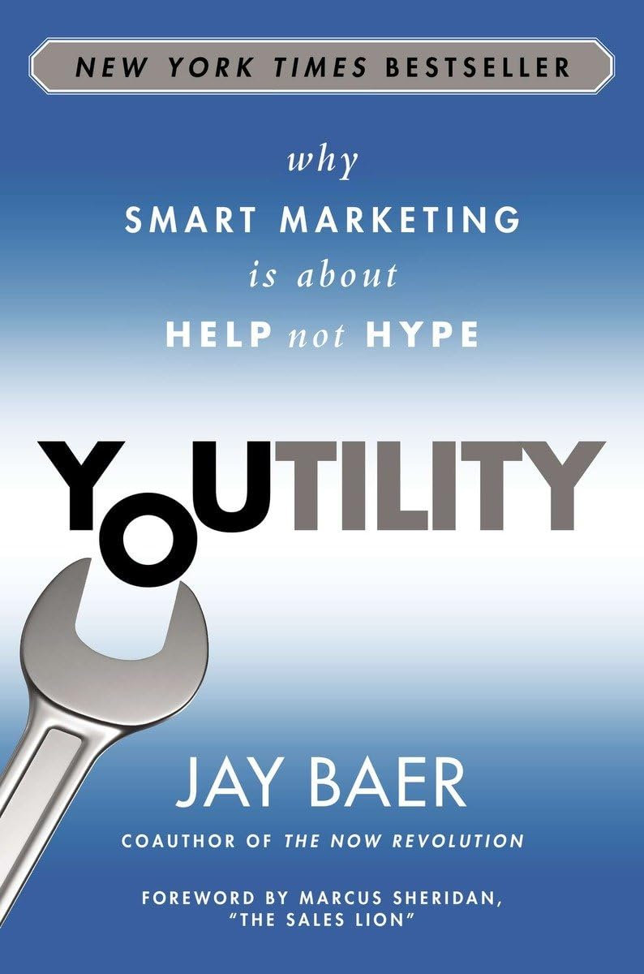
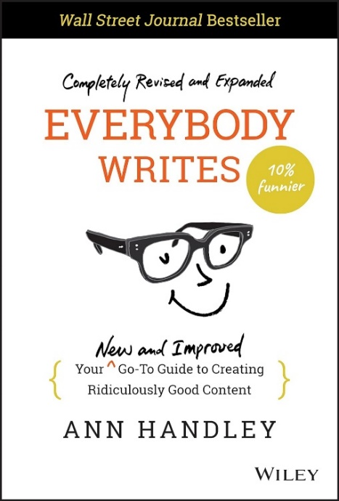
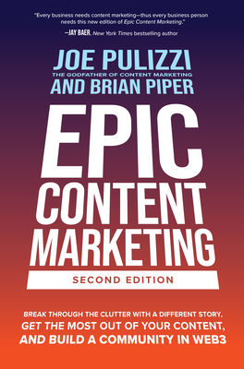
Reading List

Slide 35
Thank you!!!
Chris Boivin
chris@librarymarketingbookclub.org
linkedin.com/in/chrisboivin
1-904-338-2790
📚 librarymarketingbookclub.org

